Slide 1
1
Example Problems
Notes:
Production Notes: Cheryl off screen
In this video we will go over some problems that are commonly solved with recursive algorithms.

Slide 2
2
Factorial of n: n!
The factorial of n, or n! is defined as follows:
0! = 1
n! = n x (n -1)! (n > 0)
The base case: n is equal to 0
The second formula is a recursive definition
Notes:
Cheryl Notes:
Mathematicians often use recursive definitions of formulas that lead naturally to recursive algorithms
Examples include:
factorials
powers
greatest common divisors (gcd)

Slide 3
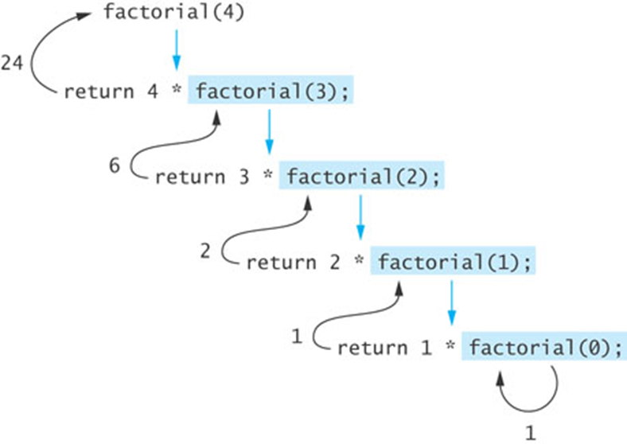
3
Factorial of n: n!
int factorial(int n) {
if (n == 0)
return 1;
else
return n * factorial(n – 1);
}
Notes:
Here is code and a trace of the factorial algorithm
Cheryl Notes:
Is there a base case?
Is there a recursive case?
Does each recursive case work toward the base case?
What happens if n<0?
If you call method factorial with a negative argument, the recursion will not terminate because n will never equal 0
If a program does not terminate, it will eventually overflow the stack
Make sure your recursive methods are constructed so that a stopping case is always reached. Answering the question whether each recursive case works toward the base case will help with this.

Slide 4
4
Recursive Algorithm for Calculating x^{n}
Recursive Algorithm for Calculating x^{n} (n ≥ 0)
if n is 0
The result is 1
else
The result is x × x^{n–1}
Notes:
Production Notes: Cheryl comes on screen? Using pointer? on
Cheryl Notes:
Here is an algorithm for calculating x to the nth power.
Look at base case, recursive case and whether recursive case leads to base case.

Slide 5
5
Recursive Algorithm for Calculating x^{n}
double power(double x, int n) {
if (n == 0)
return 1;
else
return x * power(x, n – 1);
}
Notes:
Cheryl Notes:
Here is the code.
Look at base case, recursive case and whether recursive case leads to base case.

Slide 6
Better Recursive Power Algorithm
We can write this in a more efficient way…
x⁸ = x⁴x⁴
x⁴ = x²x²
x² ⁼ x*x
x⁸ could be calculated in 3 recursive calls
That’s O(log n)
Let’s write a log n algorithm to raise a number to a power

Slide 7
Better Recursive Power Algorithm
float recPower2(float x, int n)
{ float tempResult;
if (n<0) //return inverse of x and –n
if (n==0) //base case 1
if (n==1) //base case 2
if ((n%2)==0) //even
if ((n%2)==1) //odd
}
return 1/recPower(x, (0-n));
return 1;
QUESTION 1

Slide 8
Better Recursive Power Algorithm
float recPower2(float x, int n)
{ float tempResult;
if (n<0) //return inverse of x and –n
if (n==0) //base case 1
if (n==1) //base case 2
if ((n%2)==0) //even
if ((n%2)==1) //odd
}
return 1/recPower(x, (0-n));
return 1;
return x;
{
tempResult = recPower2(x, n/2);
return tempResult*tempResult;
}
QUESTION 2

Slide 9
Better Recursive Power Algorithm
float recPower2(float x, int n)
{ float tempResult;
if (n<0) //return inverse of x and –n
if (n==0) //base case 1
if (n==1) //base case 2
if ((n%2)==0) //even
if ((n%2)==1) //odd
}
return 1/recPower(x, (0-n));
return 1;
return x;
{
tempResult = recPower2(x, n/2);
return tempResult*tempResult;
}
{
tempResult = recPower2(x, n/2);
return x*tempResult*tempResult;
}

Slide 10

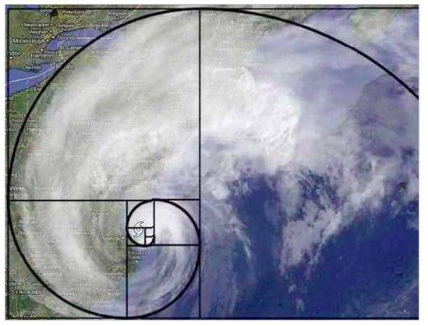
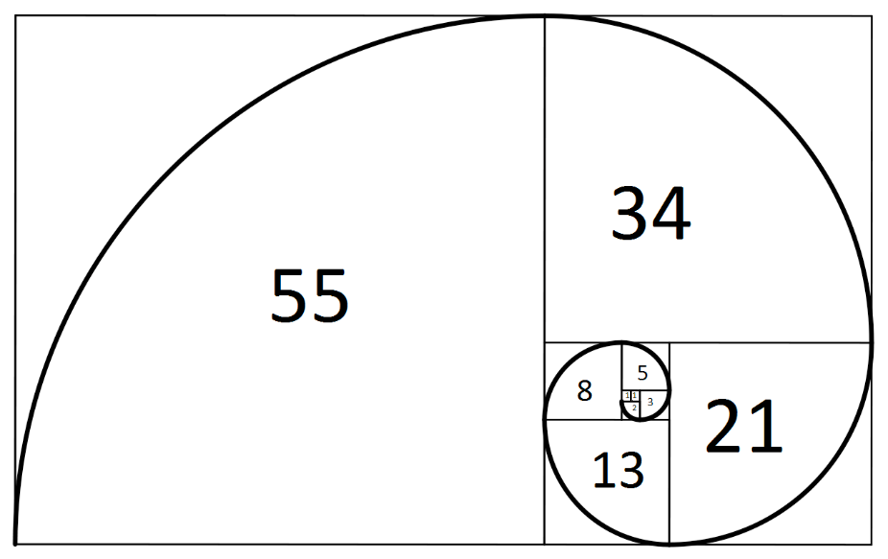
8
Fibonacci Numbers
Fibonacci numbers were used to model the growth of a rabbit colony
fib₁ = 1
fib₂ = 1
fib_{n} = fib_{n-1} + fib_{n-2}
1, 1, 2, 3, 5, 8, 13, 21, 34, 55, 89, 144, …
Notes:
Cheryl Notes:
Mathematicians like to study Fibonacci numbers because they model growth and are found in nature.

Slide 11
9
An Exponential Recursive Fibonacci Method
public static int fibonacci(int n) {
if (n <= 2)
return 1;
else
return fibonacci(n - 1) + fibonacci(n – 2);
}
Notes:
\
Cheryl Notes:
Here’s some recursive code for calculating Fibonacci numbers.

Slide 12
10
Efficiency of Recursion: Exponential Fibonacci
fibonacci(5)
fibonacci(4)
fibonacci(3)
fibonacci(3)
fibonacci(2)
fibonacci(2)
fibonacci(1)
fibonacci(2)
fibonacci(1)
Notes:
Cheryl Notes:
Here’s the trace.
What’s the problem?
Multiple identical recursive calls.

Slide 13
11
An O(n) Recursive Fibonacci Method
public static int fibo (int fibCurrent, int fibPrevious, int n) {
if (n == 1)
return fibCurrent;
else
return fibo(fibCurrent + fibPrevious, fibCurrent, n - 1);
}
Notes:
Cheryl Notes:
Here’s a better way. It actually goes in the opposite direction, and starts with 1 and 0 and builds up.
It uses a helper function to start the process.
public static int fibonacciStart(int n) {
return fibo(1, 0, n);
}

Slide 14
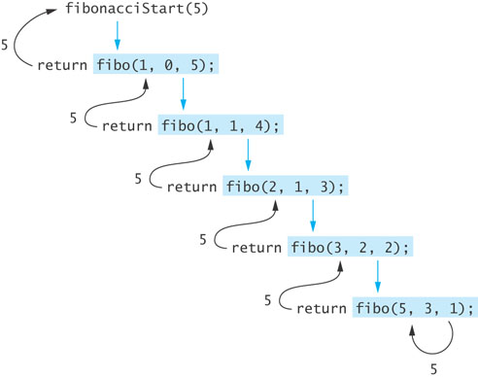
12
Efficiency of Recursion: O(n) Fibonacci
Notes:
Cheryl Notes:
Here’s the trace. Notice it starts with 1, 0 and builds up/

Slide 15
6
Recursive Algorithm for Calculating gcd
Given 2 positive integers m and n (m > n)
if n is a divisor of m
gcd(m, n) = n
else
gcd (m, n) = gcd (n, m % n)
Notes:
Cheryl Notes:
The greatest common divisor (gcd) of two numbers is the largest integer that divides both numbers
The gcd of 20 and 15 is 5
The gcd of 36 and 24 is 12
The gcd of 38 and 18 is 2
The gcd of 17 and 97 is 1
Let’s trace a few of these using the algorithm.
gcd(36, 20)
gcd(20, 16)
gcd(16, 4)
return 4
gcd(99, 24)
gcd(24, 3) (24*4 = 96)
return 3

Slide 16
7
Recursive Algorithm for Calculating gcd
double gcd(int m, int n) {
if (m % n == 0)
return n;
else if (m < n)
return gcd(n, m); // Transpose arguments.
else
return gcd(n, m % n);
}
Notes:
Cheryl Notes:
Here’s the code.

Slide 17
Computational Complexity Questions
Greatest Common Divisor:
O(log n) – proportional to the number of times it can be divided
Worst case – two Fibonacci numbers! (still log n)
gcd(34, 21)
gcd(21, 13)
gcd(13, 8)
gcd(8, 5)
gcd(5, 3)
gcd(3, 2)

Slide 18
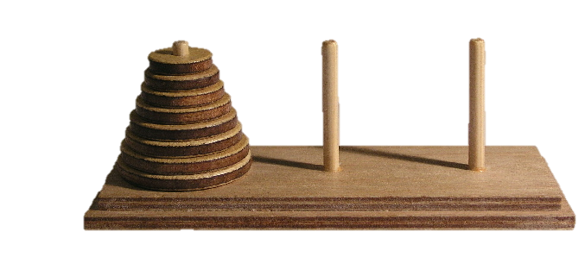
13
Towers of Hanoi
Move the three disks to a different peg, maintaining their order (largest disk on bottom, smallest on top, etc.)
Only the top disk on a peg can be moved to another peg
A larger disk cannot be placed on top of a smaller disk
Notes:
Cheryl Notes:
This is just a fun problem that is traditionally looked at in computer science classes.
The legend is that there is a room with 64 golden discs, and there are monks that must move the disks from one spindle to another, using the rules above. When they are done the task, the world will end.
If the legend were true, and if the monks were able to move disks at a rate of one per second, using the smallest number of moves it would take them 2⁶⁴ − 1 seconds or roughly 585 billion years to finish,[which is about 42 times the current age of the Universe.
So think about what the base case and recursive solutions are.

Slide 19
14
Recursive Algorithm for Towers of Hanoi
Recursive Algorithm for n -Disk Problem:
Move n Disks from the Starting Peg to the Destination Peg
if n is 1
O move disk 1 (the smallest disk) from the starting peg to the destination
peg
else
O move the top n – 1 disks from the starting peg to the temporary peg
(neither starting nor destination peg)
O move disk n (the disk at the bottom) from the starting peg to the
destination peg
O move the top n – 1 disks from the temporary peg to the destination peg
Notes:
Here is pseudocode for the algorithm

Slide 20
15
Recursive Algorithm for Towers of Hanoi
if n is 1
O move disk 1 (the smallest disk) from the starting peg to the destination
peg
else
O move the top n – 1 disks from the starting peg to the temporary peg
(neither starting nor destination peg)
O move disk n (the disk at the bottom) from the starting peg to the
destination peg
O move the top n – 1 disks from the temporary peg to the destination peg
Notes:
Cheryl Notes:
Lets go through an example
Towers(3, A, B) Move three from A to B
Towers(2, A, C) move two from A to C
Towers(1, A, B)
Towers (1, A, C)
Towers(1, B, C)
Towers(1, A, B)
Towers(2, C, B)
Towers(1, C, A)
Towers(1, C, B)
Towers(1, A, B)

Slide 21
Fun with Towers of Hanoi
Let’s assume a method call of Towers(int numDisks, char source, char destination, char spare)
Towers(3, A, B, C)
Towers(2, A, C, B)
Towers(1, A, B, C)
Towers(1, A C, B)
Towers(1, B, C, A)
Towers(1, A, B, C)
Towers(2, C, B, A)
Towers(1, C, A, B)
Towers(1, C, B, A)
Towers(1, A, B, C)

Slide 22
Computational Complexity Questions
Towers of Hanoi
n = 2 -> 3 calls
n = 3 -> 3 + 1 + 3 = 7 calls
n = 4 -> 7 + 1 + 7 = 15 calls
f(n+1) = f(n)*2 + 1, a function that doubles when n increases by 1?
2^{n}

Slide 23
Example Problem
Find a recursive algorithm for multiplying m by n using only addition.
int recMult(int n, int m)
{
//base case?
//any special cases?
//recursive case
}

Slide 24
Example Problem
Find a recursive algorithm for multiplying m by n using only addition.
int recMult(int n, int m)
{
}
if (n==1)
return m;
if (m==1)
return n;
if ((n<0)
return recMult((0-n), (0-m));
return m+recMult(n-1, m);

Slide 25
Another Example Problem
Write a recursive algorithm to convert an integer to binary
Base case?
Recursive solution?
If number is 1 or 0, return the number
Take the number mod 2: that is the least significant digit
Divide the number by two and recursively call, adding least significant digit to return from call

Slide 26
Another Example Problem
Stringresult = convert(27)
27%2 = 1
27/2 = 13
stringresult = convert(13)+’1’
13%2=1
13/2 = 6
stringresult = convert(6)+’11’
6%2=0
6/2=3
` stringresult = convert(3)+’011’
3%2 = 1
3/2 = 1
stringresult = convert(1)+1011
stringresult = 11011
Write a recursive algorithm to convert an integer to binary
Base case?
Recursive solution?
If number is 1 or 0, return the number
Take the number mod 2: that is the least significant digit
Divide the number by two and recursively call, adding least significant digit to return from call

Slide 27
Another Example Problem
Write a recursive algorithm to convert an integer to binary
string convert(int n, string result)
{ //Base case
//Recursive case
}
if (n==1)
return result+“1”;
if (n==0)
return result+“0”;
int remainder = n % 2;
if (remainder ==1)
return convert(n/2), result+”1”);
else
return convert((n/2), result+”0”);

Slide 28
16
Notes:
Production Notes: Cheryl off screen

